Slide 1
Where to Invest in France Real Estate
IBM Coursera

Slide 2
Analysis
Each year around 100,000 families look for a house to rent. But the supply remaining below the demand, it is estimated that it would be necessary to build 15,000 houses per year for a decade to meet the needs. In short, if they are correctly placed and their rents are in line with the market, the houses can be rented without difficulty.
In France, buying or renting a house or an apartment is affordable depending on the cities and departments. Real estate in urban areas and real estate in rural areas also do not have the same prices.

Slide 3
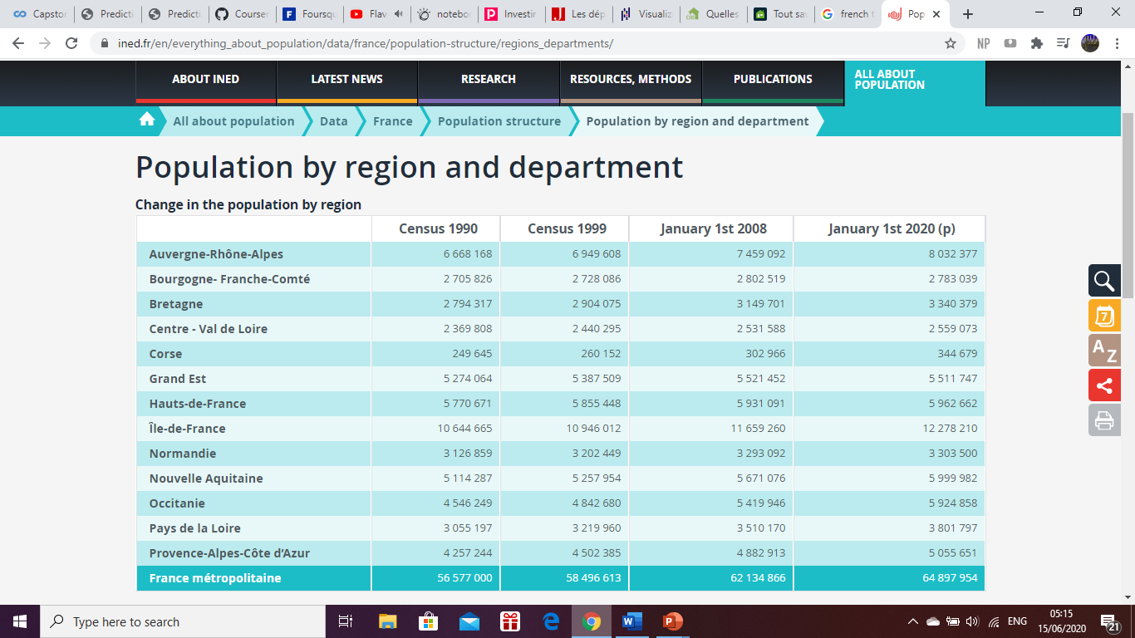
Population (Region)

Slide 4
Data Aquicision
I used the French statistics web sites to gather all the information I needed for my project, based on the information I gathered the following factors were analysed in order to get a better solution out of the problem be :
The GDP per capita of all departments in France
The Total Population of each departments
Data source : https://www.ined.fr/en/everything_about_population/data/france/population-structure/regions_departments/
Data source : https://en.wikipedia.org/wiki/List_of_French_regions_and_overseas_collectivities_by_GDP#Departments_by_GDP

Slide 5
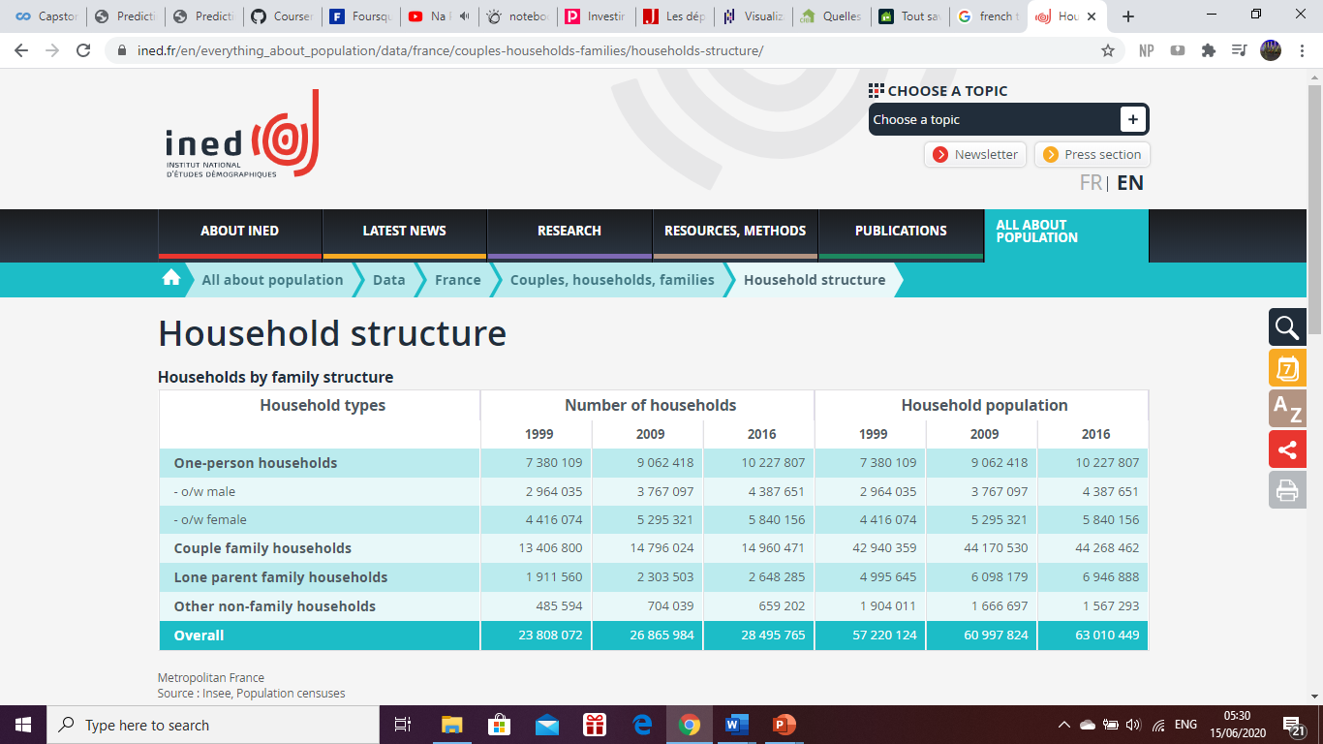
Popylar Type of House
The individual house shows a gross rental profitability

Slide 6
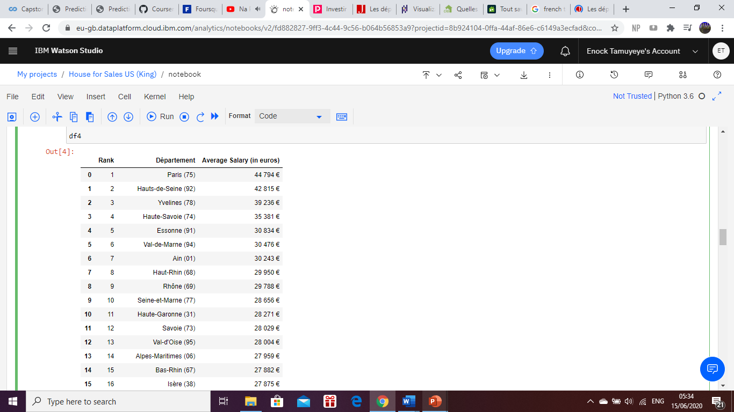
Average Salary Per Department

Slide 7
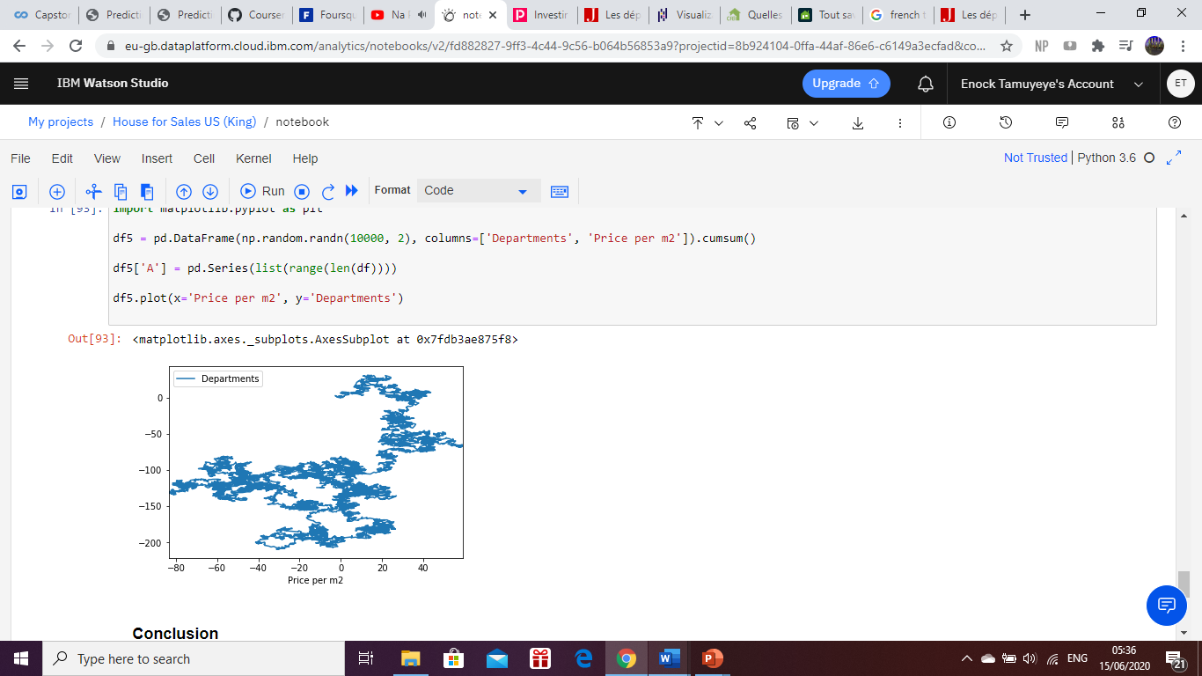
Conclusion
With a house, the risk of haircuts is limited. In the long term, in fact, prices have never fallen, as shown by the PAP index on May 1. On a 1,000 basis established on January 1, 2001, houses reached 1,700 on June 1, 2013. Above all, in twelve years, the value of houses has increased by more than 70% according to our index.
To hope for a good recovery, the houses must be located near shops, services, transport and especially schools. In other words, respect the basic rule of real estate investment: select a good location. This point is all the more important as a well-placed house will have more chances to please the tenants and will be rented at a better price.

